Slide 1
Hackathon 2024: Team02 → 911

Slide 2


Our Team
4th Year – CSE
Interests:
Data Science, Machine Learning, Competitive
Coding, Deep Learning
Projects:
A system to find available buses using machine learning.
3rd Year – CSE
Interests:
Machine Learning,
Web3.0
Projects:
Football VAR system
Using Machine learning
Shanavas R S
Joel Joseph
Team Lead
Data/ML Engineer

Slide 3



Our Team
4th Year – CSE
Interests: Machine Learning,
Deep Learning
Projects:
Football Live Score website and Match prediction
4th Year – CSE
Interests:
Leadership,
Presentation
2nd Year – CSE
Interests:
Backend ,
Presentation
Appu K
Jayakrishnan Marar
Fathima Nasrin T N
Software Engineer
Presentation
Documentation

Slide 4
Problem Statement: Why
Problem Statement:
Restaurants face challenges in identifying and addressing faults and issues highlighted in Google reviews, leading to negative impacts on their reputation and revenue.
Data:
Showcase statistics or case studies highlighting the prevalence of negative reviews and their impact on restaurants.
Importance:
Discuss the significance of addressing these issues promptly for restaurants' success and customer satisfaction.

Slide 5
Business Problem: What
Business Problem:
Restaurants lack efficient means to analyze and respond to Google reviews effectively, resulting in missed opportunities for improving customer experience and revenue.
Challenges:
Highlight specific pain points faced by restaurants in managing online reviews and addressing customer feedback.
Impact:
Discuss the negative consequences of unresolved issues and negative reviews on restaurants' reputation and profitability.

Slide 6
Our Solution : GenCraft
Overview:
Introduce GenCraft as an AI-powered marketing assistant tailored to address the unique challenges of the restaurant industry.
Features:
Highlight key features such as automated review analysis, fault identification, personalized recommendations for improvement, and email marketing campaign development.
How it Works:
Provide a brief overview of how GenCraft utilizes AI algorithms to analyze Google reviews, identify issues, and generate actionable insights for restaurant owners.

Slide 7
Economic Logic
Cost-Benefit Analysis:
Traditional Approach
Costs:
Labor Costs: Hiring staff to manually monitor and analyze Google reviews.
Time Costs: Time spent manually identifying faults and issues in reviews.
Opportunity Costs: Missed revenue due to negative reviews impacting customer retention.
Benefits:
Limited: Manual analysis may not cover all reviews, leading to overlooked issues.
Reactive: Responses to reviews may be delayed, affecting customer satisfaction.
GenCraft Approach:
Costs:
Initial Setup: One-time investment for integrating GenCraft with existing systems.
Benefits:
Time Savings: Automated review analysis reduces labor costs and frees up staff time.
Enhanced Efficiency: AI-powered fault identification streamlines issue resolution.
Proactive Response: Prompt action on identified issues improves customer satisfaction.
Increased Revenue: Improved online reputation leads to higher customer retention and revenue generation.

Slide 8
Economic Logic
ROI Potential:
Traditional Approach:
Limited: ROI may be minimal due to inefficiencies in manual processes.
Reactive: Responses to negative reviews may not fully mitigate damage to reputation.
Missed Opportunities: Lack of proactive measures may result in continued revenue loss.
GenCraft Approach:
Significant: Cost savings and revenue increases justify the investment in GenCraft.
Proactive: AI-driven insights enable proactive responses, minimizing reputation damage.
Growth Potential: Improved online reputation attracts new customers and fosters growth
Value Proposition:
GenCraft:
Cost-Effective Solution: GenCraft offers a cost-effective alternative to labor-intensive manual processes.
Operational Efficiency: Automation streamlines review analysis and response, maximizing efficiency.
Revenue Generation: Enhanced online reputation leads to increased customer retention and revenue.
Long-Term Growth: Investing in GenCraft ensures sustainable growth and competitiveness in the market.

Slide 9
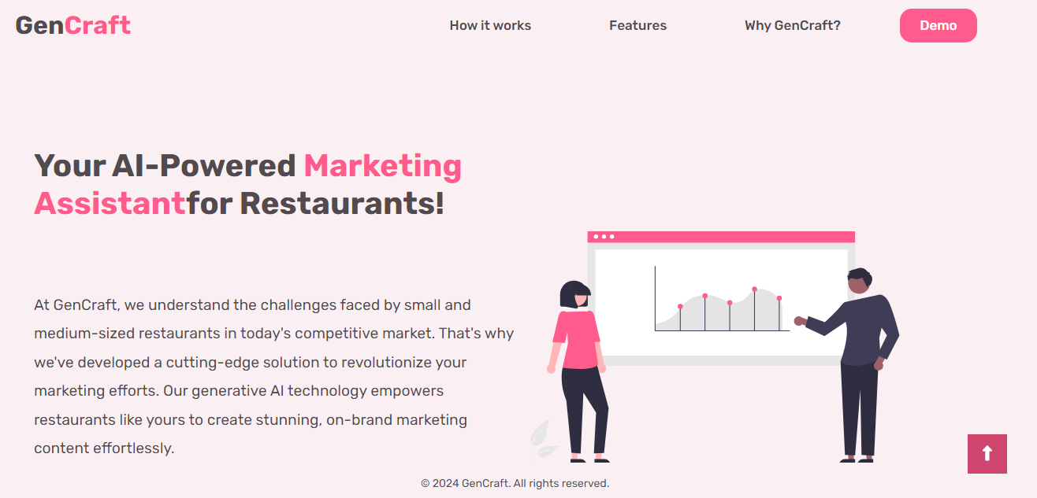
GenCraft Demo

Slide 10
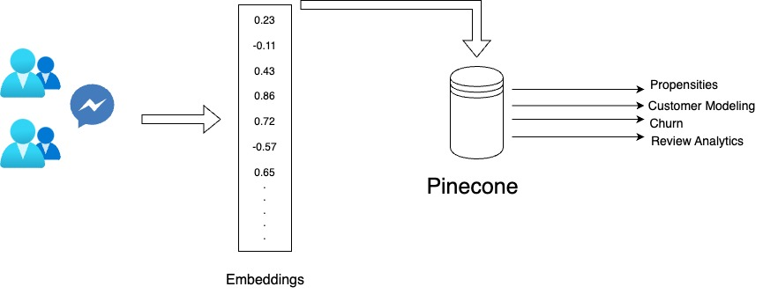
GenCraft Demo

Slide 11
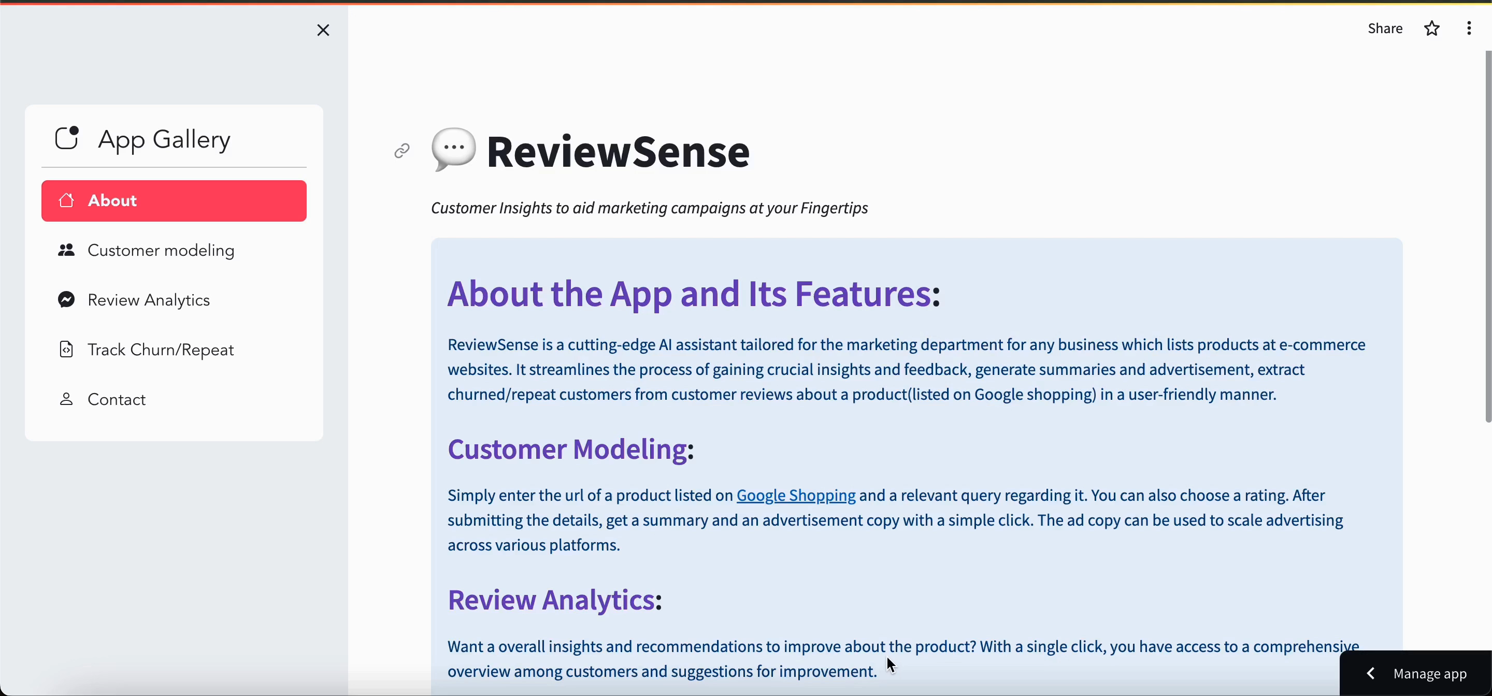
GenCraft Demo

Slide 12
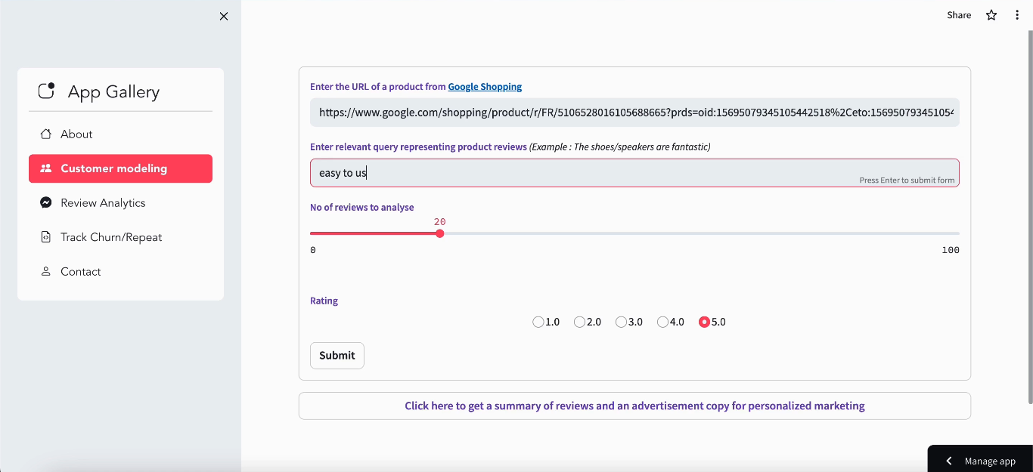
GenCraft Demo

Slide 13
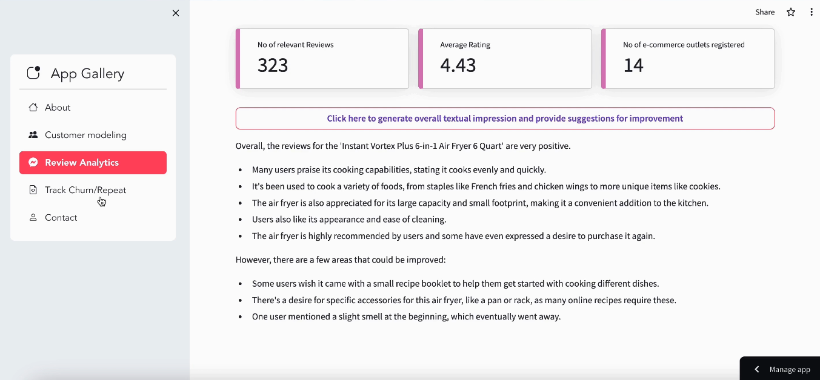
GenCraft Demo

Slide 14
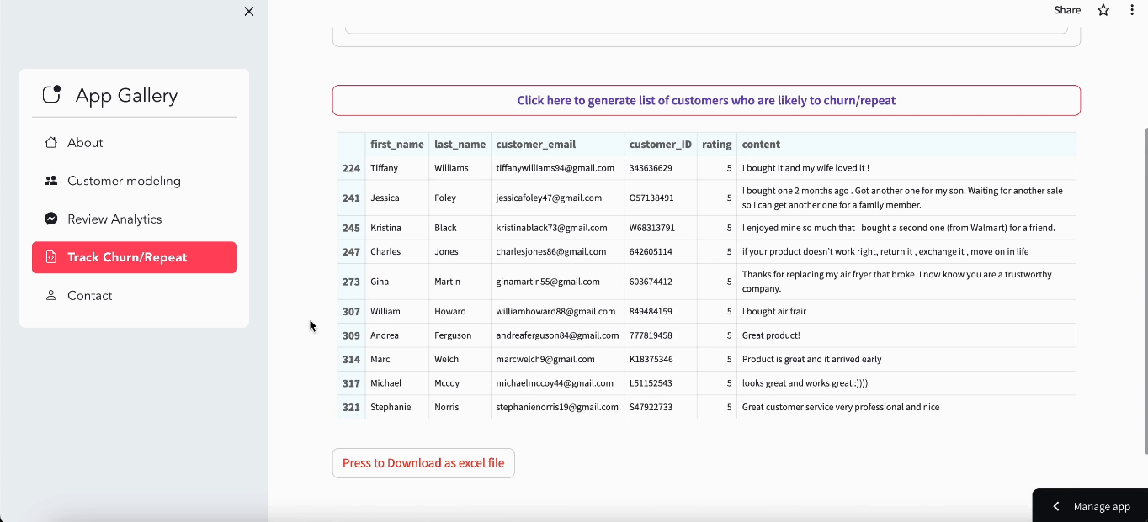
GenCraft Demo

